Slide 1


Topic on:-
Presented By:-
Sai varun Reddy
Batch - 15

Slide 2
AGENDA:-
What is SQS?
Example for SQS
How it works
Types of queue
How FIFO SQS works
How Standard SQS works
Advantages & Limitations of SQS
What is MQ?
Example of MQ
Advantages & Limitations of MQ
Difference between SQS & MQ

Slide 3


Slide 4
SQS stands for Simple Queue Service.
SQS is a message queuing service.
It exchanges and stores messages.
The service adds the messages in a queue.
Users or services pick up the messages from the queue.
Once processed the messages gets deleted from the queue.

Slide 5
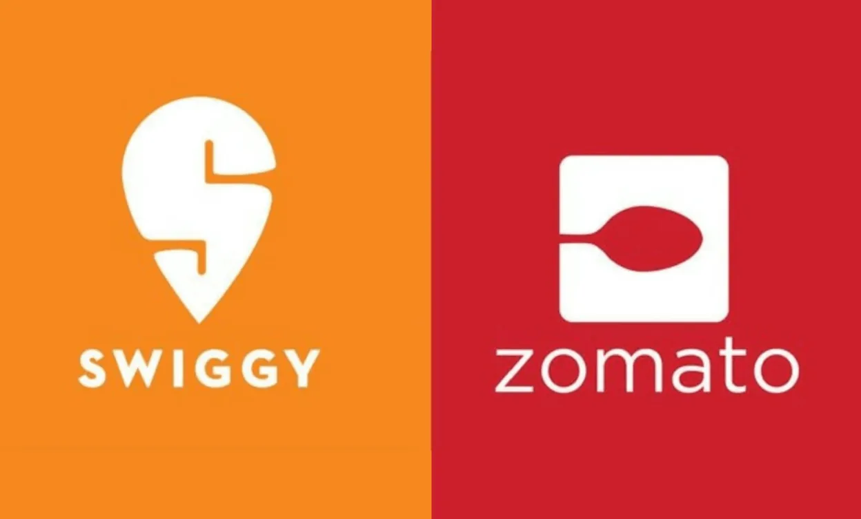
Example: Food Delivery Application (Using AWS SQS):-
1. Order Placed
User places an order.
Order Service sends message → “New order created” → SQS Queue: OrderQueue
2.Payment Service Reads Message
Payment Service polls (reads) messages from OrderQueue.
It processes payment and sends new message → “Payment successful” → SQS Queue: PaymentQueue
3.Notification Service
Reads from PaymentQueue → sends SMS/email confirmation.
4.Delivery Service
Also reads from PaymentQueue → assigns delivery partner.

Slide 6
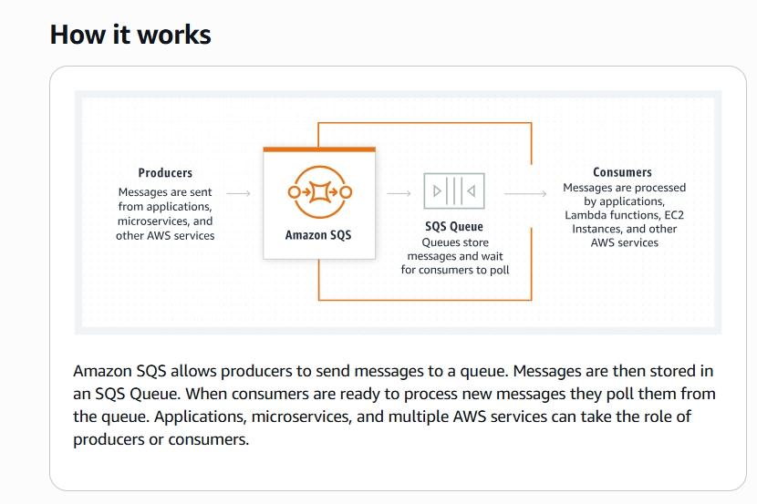

Slide 7
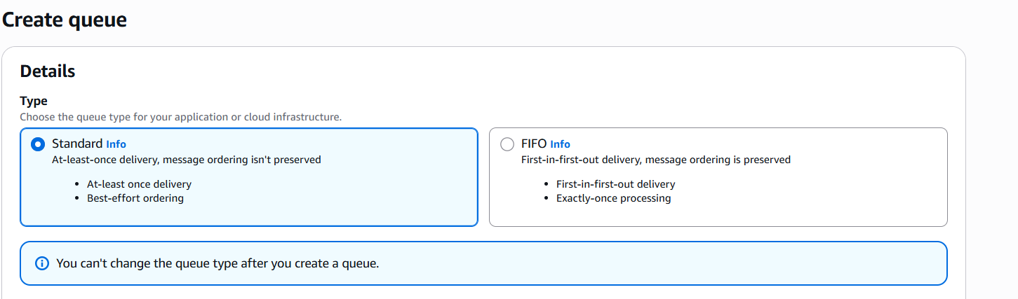
Standard queue
Standard queues support a nearly unlimited number of transactions per second (TPS) per API action (SendMessage, ReceiveMessage, or DeleteMessage). A message is delivered at least once, but occasionally more than one copy of a message is delivered. Standard queues provide best-effort ordering. Occasionally, messages might be delivered in an order different from which they were sent.
FIFO queue
FIFO queues support up to 3000 messages per second, each message is delivered exactly once, and message order is preserved. FIFO queues are designed to enhance messaging between applications when the order of operations and events is critical, or where duplicates can't be tolerated.

Slide 8
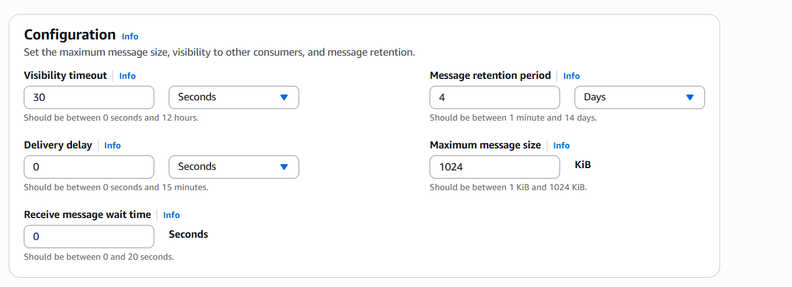

Slide 9
🎬 Scenario: Online Ticket Booking System
How FIFO SQS works:-
User A, User B, and User C all try to book the same seat at 10:00:00.
2. Their booking requests go into the FIFO SQS queue in this order: A → B → C
3. The backend server (consumer) processes requests in exactly that order.
A’s booking is processed first → seat gets reserved.
When B’s request comes next → system sees seat is taken → sends “Seat Unavailable”.
C’s request is processed last → same result
.
No duplicate bookings
Exact order maintained

Slide 10
How standard SQS works:-
Users A, B, and C all try to book different seats — A1, A2, and A3 — at the same time.
2. All requests are sent to the Standard SQS queue.
3. The backend system (consumers) reads the messages and processes them as quickly as possible, but order isn’t guaranteed.
Possible Message Order
If messages entered as: A → B → C
They might be processed as: B → A → C (out of order)
This happens because Standard queues focus on speed and scalability, not order.
What Happens in Real Life:-
For different seats, this is perfectly fine — no harm if seat A2 is booked before A1.
But if multiple users try to book the same seat (A1), there’s a small chance that duplicate booking requests might be processed simultaneously because Standard SQS guarantees at-least-once delivery, not exactly-once

Slide 11
Advantages of Amazon SQS:-
Fully managed – No need to manage .
Scalable – Handles any number of messages easily.
Reliable – Messages are safely stored and never lost.
Low cost – Pay only for what you use.
Decouples apps – Lets different parts of an app work independently.
Disadvantages of Amazon SQS:-
No guaranteed order (in standard queue).
Limited message size (max 1024KB previously it is 256 KB only).
Possible duplicate messages.
No built-in message filtering or routing.
Uses AWS-only APIs (not standard protocols).

Slide 12

What is AWS MQ?

Slide 13
AWS MQ is a managed message broker service that helps applications send messages to each other reliably.
It supports popular open-source brokers like Apache ActiveMQ and RabbitMQ, making it easy to migrate existing setups.
Think of AWS MQ as a post office for your applications.
Applications can send and receive messages (data, requests, events) through the broker instead of talking directly.
This helps systems work smoothly even if one part is slow or temporarily down.
Types of AWS MQ:- It offers two main broker engine types — both are fully managed message brokers.
1. ActiveMQ Broker
2. RabbitMQ Broker
ActiveMQ → Good for traditional enterprise systems (Java/JMS).
RabbitMQ → Good for modern, fast, scalable applications (microservices, IoT).

Slide 14
Example :- Banking Transaction System
A large banking application needs to process: Fund transfers; Credit card payments; Loan approvals; Notification.
How It Works (Step-by-Step)
Customer initiates a fund transfer The frontend banking app sends a message like {"TransactionID": 1001, "Amount": 2000, "From": “varun", "To": “sai"} to AWS MQ broker (ActiveMQ).
Message Stored Safely
AWS MQ stores this transaction message in a queue/topic (for example, TransactionQueue).
The message won’t be lost — even if the next service is down.
Backend Core System Reads Message
The Core Banking System (on-premise) subscribes to the same queue.
It reads the message, processes the fund transfer, and updates customer balance.
Notification Service
Another service subscribed to the topic gets notified automatically (via pub/sub model).
It sends a confirmation SMS or email: “Your transfer of ₹2000 was successful.”

Slide 15
Advantages of AWS MQ:-
Fully managed – AWS handles setup, scaling, and maintenance.
Supports standard protocols – Works with JMS, AMQP, MQTT, STOMP, etc.
Reliable – Messages are safely stored until delivered.
Good for legacy systems – Easy to connect old enterprise apps (like Java systems).
Supports pub/sub model – One message can go to many receivers.
Disadvantages of AWS MQ:-
More complex – Setup and management are harder than SQS.
Higher cost – You pay for broker uptime, not just messages.
Slightly slower – Because it handles more features and protocols.
Not auto-scaling like SQS – Needs manual scaling for high loads.
Overkill for simple apps – Too advanced if you just need basic queuing.

Slide 16
Difference between Amazon SQS VS Amazon MQ:-
Features | Amazon SQS | Amazon MQ
Messaging Pattern | It works on Queue-based i.e., point-to-point | It also works on Queue based i.e., ( Point-to-Point )
Protocol Support | It works with protocols such as HTTP/HTTPS , AWS SDKs | It works on protocols AMQP, MQTT, OpenWire, STOMP
Message Retention | It is Configurable | It is Configurable
Message Ordering | It provides best-effort ordering | It provides guaranteed ordering
Consumer Control | It is pooling by Consumers | It is dedicated to consumers instances

Slide 17


Slide 18


